Slide 1
Unit 12
What did you do last weekend?
Section A Grammar Focus-3c
七年级下册

Slide 2

Objectives
To learn to make sentences with what, who, and where
To learn the past form of the verbs

Slide 3

Let's stuy together

Slide 4
Do you know their meanings?
go shopping 去购物
go camping 去野营
go boating 去划船
go fishing 去钓鱼

Slide 5
当play与表示球类或棋类运动的名词连用时，不用定冠词。表示演奏某种乐器时，要与定冠词the连用。
e.g. play football 踢足球
play baseball 打篮球
play the piano 弹钢琴
play the violin 拉小提琴

Slide 6
Grammar Focus
What did you do last weekend? | I did my homework./ we went boating.
Who visited her grandma? | Becky did.
Where did she go last weekend? | She went to a farm.
Who did she go with? | She went with her classmates.

Slide 7
阅读Grammar Focus部分，完成下列句子。
上个周末你做什么了？
___________________________
2. 我做了我的家庭作业。 __________________
What did you do last weekend?
I did my homework.

Slide 8
We went boating.
我们去划船了。_______________
谁去探望了她的奶奶？
_______________________
5. 是蓓基._________
上个周末她去了哪里？ ___________________________
Who visited her grandma?
Becky did.
Where did she go last weekend?

Slide 9
7. 她去了农场。
____________________________
8. 她和谁一起去的？
____________________________
9. 她和她的同学们一起去的。
____________________________
She went to the farm.
Who did she go with?
She went with her classmates.

Slide 10

探究乐园
一、一般过去时态的特殊疑问句。
1. 特殊疑问词 +was/were + 主语
+ 其他？
上个周末你过得怎么样？
_____ ____ your last weekend?
How was

Slide 11
昨天下午他们在哪里？
_______ _____ they yesterday afternoon?
昨天晚上谁在教室里？
____ ____ in the classroom last night?
昨天你为什么迟到了?
_____ _____ you late yesterday?
Where were
Who was
Why were

Slide 12
2. 特殊疑问词 + did + 主语 + 动词原形 +其他？
昨天他做了什么事情？
_____ ____ he do yesterday?
上个周末她参观了什么地方？
______ ____ she _____ last weekend?
你和谁一起去的动物园？
____ ____ you go to the zoo _____?
他们什么时候到达北京的？
_____ ____ they arrive in Beijing?
What did
Where did visit
Who did with
When did

Slide 13

对下列句子中的划线部分提问。
1. I got up at nine yesterday morning.
______ ___ you get up yesterday morning?
2. We did our homework last night.
_____ ____ you ___ last night?
When did
What did do

Slide 14
3. They were in the supermarket last Sunday.
_______ _____ they last Sunday?
My last weekend was kind of boring.
_____ _____ your last weekend?
Linda took a walk with her parents after dinner.
_____ ____ Linda take a walk with after dinner?
Where were
How was
Who did

Slide 15
Grammar
一般过去时
1.定义: 1) 表示过去某个时间发生的动作或存在
的状态,常和表示过去的时间状语(如yesterday,
last night, in 1990, two days ago...)连用;
2) 也表示过去经常或反复发生的动作, 常和表示
频度的时间状语(如often, always…)连用。

Slide 16
2. 句子构成: “主语+动词的过去式+其他”;
系动词be的过去时: am (is) →was
are → were
陈述句:主语+be动词的过去式+其他
否定句:主语+be动词的过去式+not+其他
疑问句: be动词的过去式+主语+其他?

Slide 17
e.g. Mike was in the United States last year.
Mike was not (wasn’t) in the United States
last year.
--Was Mike in the United states?
--Yes, he was./No, he wasn’t.
They were at home yesterday.
注意:带有be动词的过去时的句子,一定要看清
主语再正确选择用was还是were.

Slide 18
2) 行为动词的一般过去时:
陈述句: 主语+动词过去式+其它
I go to the movie. →I went to the movie.
否定句: 主语+助动词didn’t+动词原形+其它
I don’t go to school today.
→I didn’t go to school.
一般疑问句: Did +主语+动词原形+其它
Do you have breakfast?
→Did you have breakfast?

Slide 19
我们在一般现在时中学过:当谓语动词为行为
动词时,在句子变成疑问句或否定句时, 我们
必须加上助动词do或does, 而在过去时中,
我们借助did这个词来完成。
e.g. He played football yesterday.
He didn’t play football yesterday.
--Did he play football yesterday?
--Yes, he did./No, he didn’t.
注意:在否定句或者疑问句中,有了助动词did后,行
为动词要还原, 不能再写成过去式.

Slide 20
3. 规则动词过去时的变化规则
构成方法 | 原形 | 过去式
一般情况在动词原形后加-ed | want answer | wanted answered
以字母e 结尾的动词，只加-d | move die | moved died
以“ 辅音字母+y ”结尾的动词，把y 改为i,再加-ed | carry cry | carried cried
以重读闭音节结尾，末尾只有一个辅音字母，先双写该辅音字母，再加-ed | stop plan | stopped planned

Slide 21
动词不规则变化
am, is—was are—were
go—went do—did
have—had come—came
take—took say—said
eat—ate see—saw
get—got put—put
sleep—slept give—gave
write—wrote read—read
/red/

Slide 22
巧记动词过去时态
动词一般过去时， 表示过去发生的事；
be用was或用were, have , has变had；
谓语动词过去式， 过去时间作标志；
一般动词加-ed， 若是特殊得硬记。
否定句很简单， 主语之后didn’t添；
疑问句也不难， did放在主语前；
如果谓语之前有did， 谓语动词需还原；
动词若是was, were, 否定就把not添。

Slide 23
3a. Fill in the blanks with who, what,
when, where, or how.
1. A: _____ did you do last weekend?
B: I played badminton on Saturday.
A: Sounds fun.____ did you play with?
B: I played with my father. He’s really good!
What
Who

Slide 24
2. A: _____ was your weekend?
B: It was great. I had so much fun.
A: _____ did you go?
B: The weather was beautiful, so I went to the
beach with my parents.
3. A:_____ did Jim lose?
B: He lost his keys. He often loses things.
A: That’s too bad._____ did he lose them?
B: I heard it was yesterday.
How
Where
What
When

Slide 25
3b. Complete the passage with the correct
forms o f the words in the box..
say be climb see run away
A family of mice were in the kitchen on
Saturday morning when they ______ a big
cat. Baby Mouse_____ afraid and _______
onto his father’s back. Father Mouse shouted at the cat, “ Woof, woof!” The cat quickly________. “Wow, Dad, you’re good!”______ Baby Mouse. “Well, son, that’s why it’s important to learn a second language,” answered Father Mouse.
saw
was
climbed
ran away
said

Slide 26
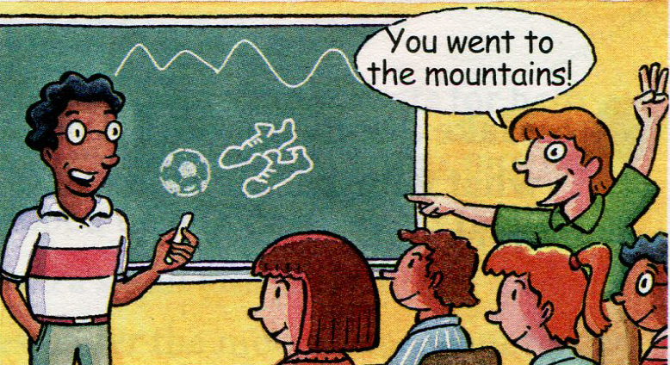
3c. Think of two things you did last
weekend. Draw pictures of them. Your
classmates guess what you did.

Slide 27
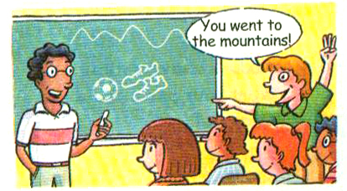
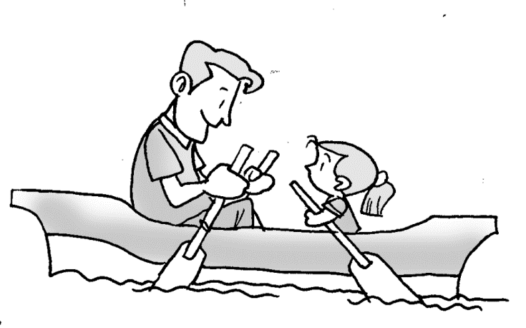
What did I do?
You went boating.
You went with your daughter?

Slide 28

Take some photos of your vacations to school. Ask and answer about your vacations.

Slide 29
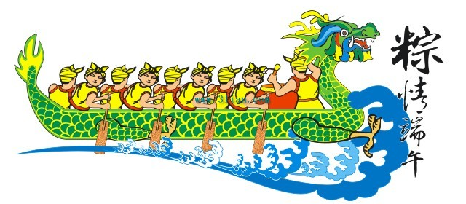
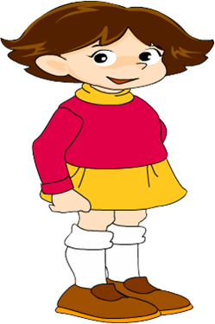
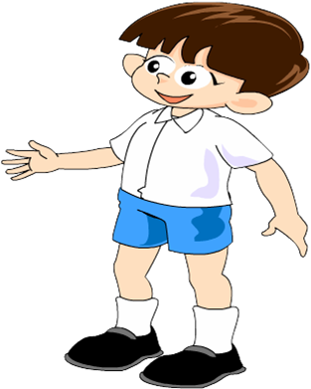
Where did you go on Dragon Boat Day?
I went to the countryside.
What did you do there?
I watched the boat race.

Slide 30
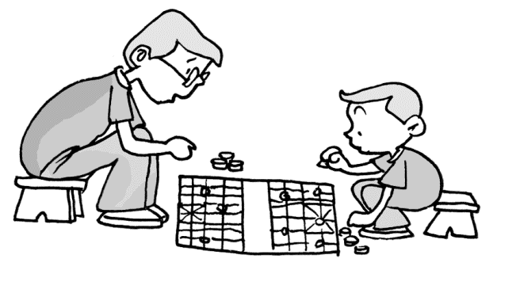
What did you do last weekend?
I played chess.
Who did you play with?
With my uncle.

Slide 31
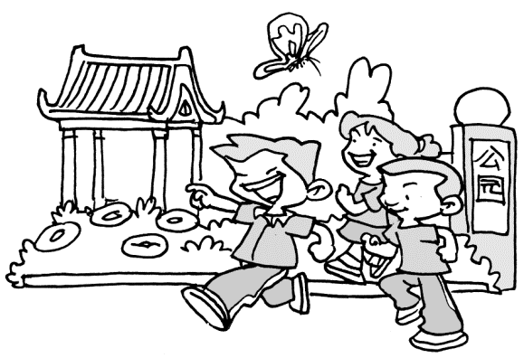
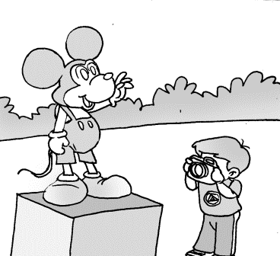
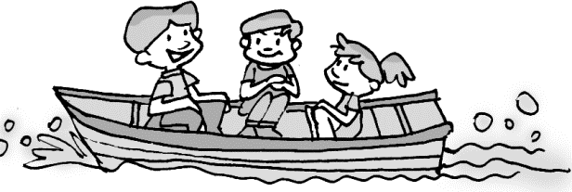
Practice
1. Look at the pictures, and read the
conversation then fill in the blanks.
was
A: How ____ your last weekend?
B: It was great.

Slide 32
A: _______ did you go?
B: I went to the _____.
A: _____ did you go _____?
B: I went with my classmates.
A: ______ did you do there?
B: We _____ ________ and _____ some photos.
Where
park
Who with
What
went boating took

Slide 33
2. 从方框中选择恰当的单词，并用其正确形式填空。
say look get walk ask have
Mr. Jones went to the mountains for a holiday. He ________ to the train station and ____ on the train on Sunday morning.
walked
got

Slide 34
He ____ a new hat. He often put his head out of the window to _____ at the mountains. But the wind pulled his hat off. He quickly threw his old bag out of the window. Some people ______ “Why?”. He ____, “There’s no name and address on my hat, but there’s my name and address on my bag.”
had
look
asked
said

Slide 35
3.用适当单词填空
1. 我今年12岁。 我去年11岁。
I ______ twelve years old this year.
I ______ eleven years old last year.
2. 他现在在北京。他昨天在上海。
He ______ in Beijing now.
He ______ in Shanghai yesterday.
3. 他们今天在中国。他们昨天在日本。
They ______ in China today.
They ______ in Japan yesterday.
am
was
is
was
are
were

Slide 36
4. 用所给动词的适当形式填空
lived
1. We ______ (live) in Japan last year.
2. Jack ________ (stop) the car last Sunday.
3. Tom _______ (clean) my room and _______(study)
for the Chinese test last weekend.
4. What ______ you ______(do) last night?
5. On Sunday morning I _________(play) tennis.
stopped
cleaned
studied
did
do
played

Slide 37
6. What ______ (do) your father do last Monday?
7. Tom ________ (study) English last night.
8. Amy ________ (play) ping pong last Sunday.
9. They ________ (go) to the park last Saturday.
10. We _______ (have) a class meeting last Tuesday.
11. He ________ (watch) TV over the weekend.
12. Lily _______ (swim) last Sunday.
13. The boys _______ (visit) his uncle last Friday.
did
studied
played
went
had
watched
swam
visited

Slide 38
14. Last summer my family and I ______ (go)
to the beach.
15. When it ________ (rain), I stayed at home
and watched TV.
16. What time _____ you ______ (get) to school
this morning?
17. They _______ (be) always late for class last year.
18. What day _____ (be) it yesterday?
went
rained
did
get
were
was

Slide 39
Homework
1. 抄写本节课涉及到的动词原形, 过去式及
中文意思。 (e.g. do--- did)
2. 给你的笔友写一封信, 谈谈你及家人是
如何度过上一个周末的。 (选作)

Slide 40
Thank You!

